Slide 1

ORDER FORECAST IN OASIS STORE ORDERING PATTERN AND FORECAST
Campus Ambassador Program Hackathon

Slide 2





BRUTE FORCE
Devi Ahilya Vishwavidyalaya
AMAN NAREDI
NIKHIL GEORGE
YASH WADHAWAN

Slide 3

Contents
Understanding of problem statement | Idea overview | Technical solution process | Accuracy | Sources relied And Demo video
Success

Slide 4


UNDERSTANDING OF PROBLEM STATEMENT
OVERVIEW
Oasis Store is an internal e-commerce site in VMware to order IT Assets. VMware colleagues
place order using the store of various IT assets like laptops, monitors etc.
UNDERSTANDING
Maximum organization struggle towards fulfilling the demand of a particular product, be it the manufacturing process or the goods in inventory, the problem which arises is that all the industries are penny wise and need to keep record of even a single transaction, so in such a scenario a proper tool should be provided to the industry so as to reduce the loss incurred due to higher inventory as well as lower inventory as both the cases incur losses on a great rate so we are thriving towards producing an optimized forecasting result using machine learning keeping in mind the current technical aspects which will enhance the quality of forecasting and producing the desired pattern which will exhibit easy understanding and execution with the intention of minimum usage of inventory and program memory space with faster and efficient outcome at a cheap rate and with faster results.
EVALUATION
1. Ordering pattern basis various KPI’s
2. Ordering forecast basis various KPI’s

Slide 5

OUR BIG IDEA
Through the knowledge and understanding of the problem we propose on producing the required pattern and forecast on the basis of current dataset, and not only the past data, we are focusing on predicting the future dataset and then finding the median element forecast in order to reduce error, plus our idea is to run the test cases for the most recent values so as to give them a higher weightage according to the present scenario and how well a product has performed in the recent years. Also a particular amount of data will be tested against the output value again and again to calculate the error percentage and parallelly running the time series analysis to learn from the error generated to be as close to the real ordering value. The technical aspect for this idea is shared in a step wise manner from the next slide.

Slide 6
SOLUTION PROCESS OUTLOOK
DATA ANALYSIS | TIME SERIES ANALYSIS | NORMALIZING DATA | FORECASTING | PATTERN PLOTTING
Cleaning Filling Nans Dropping Nans | Series decomposing Checking stationarity | Reducing varaince | Fitting normalized data to models Linear regression Chatboost ARIMA/ SARIMA RNN, LSTM, BLSTM | Ordering Pattern plot using various data representation tools
SUCCESS

Slide 7

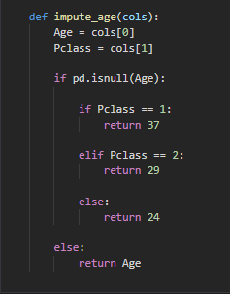
Data analysis
Describing statistical property of data
Checking missing values and if any then,
Filling numerical missing values via,
Mean
Median
Interpolation
If possible, else an example:-
removing
the element.
And analyzing
non-numerical
values via
clustering
of common
categories.

Slide 8
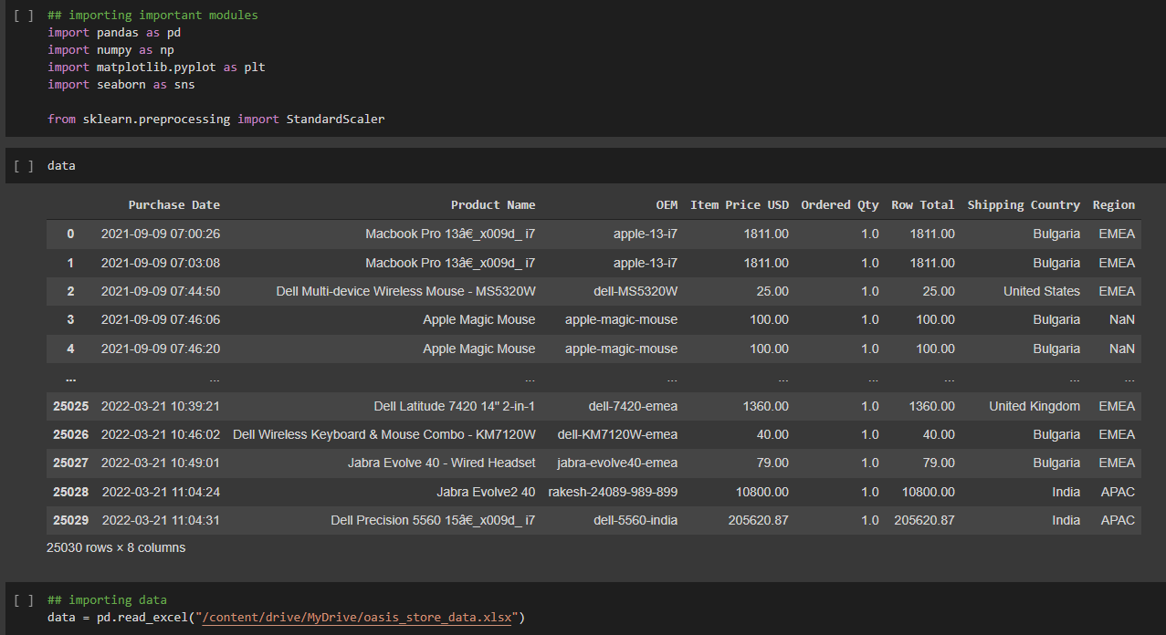
Initial analysis(code)

Slide 9
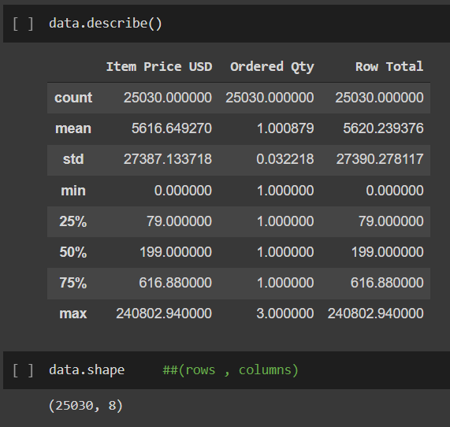
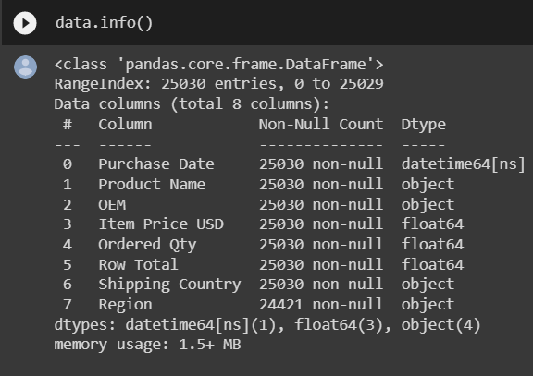
Data analysis (code)

Slide 10
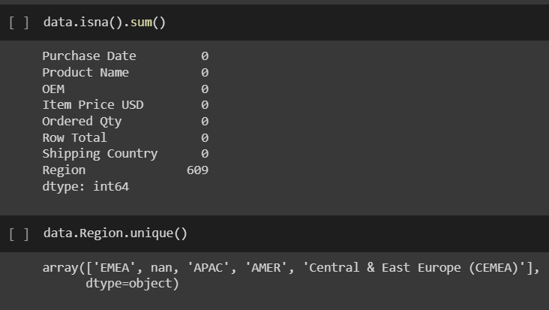
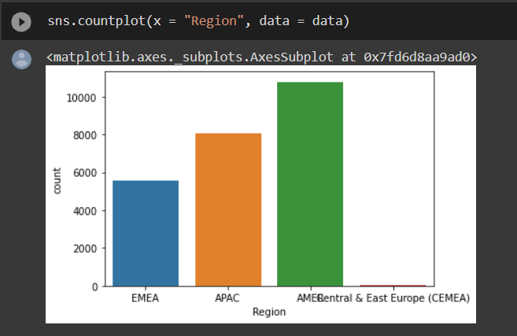
Data analysis (code)

Slide 11
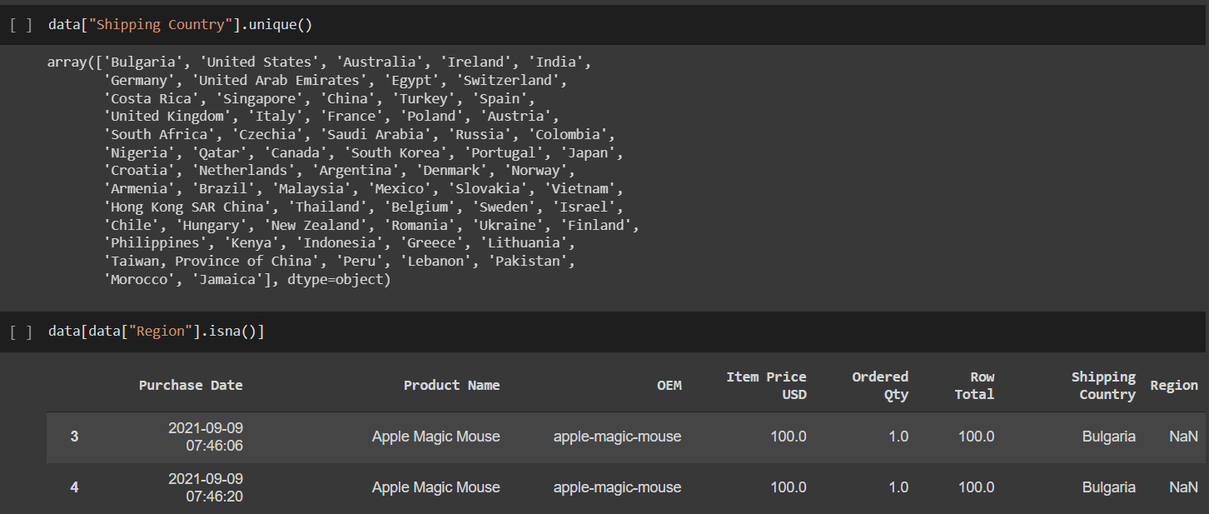
Data analysis (code)

Slide 12
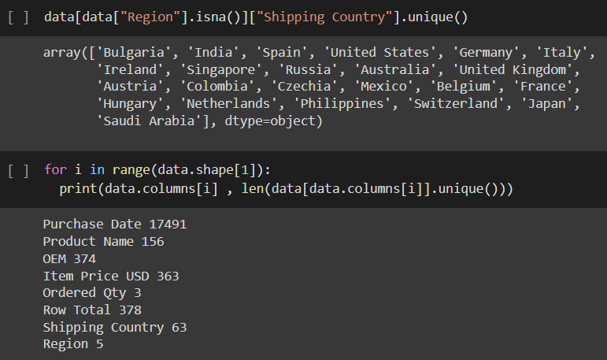
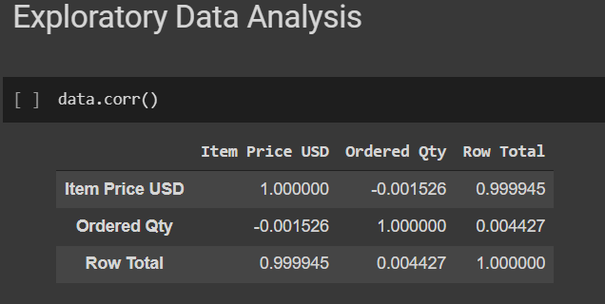
Data analysis (code)

Slide 13
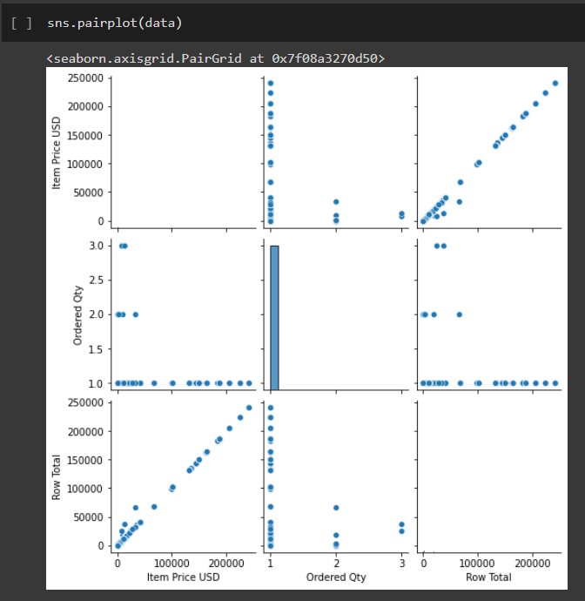
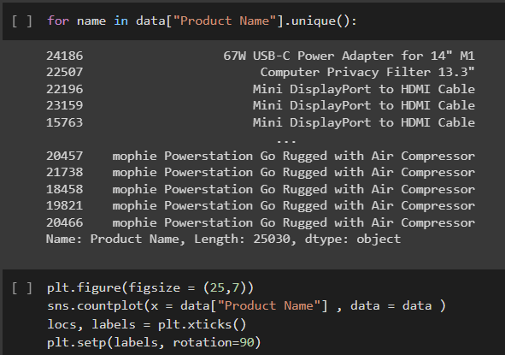
Data analysis (code)

Slide 14
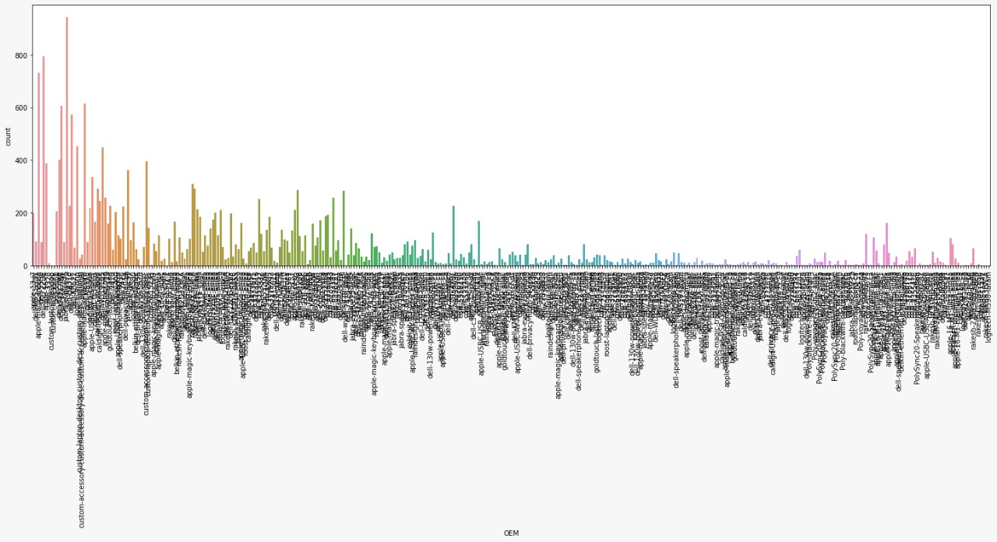
Data analysis (pattern)

Slide 15
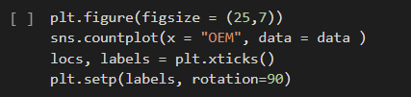
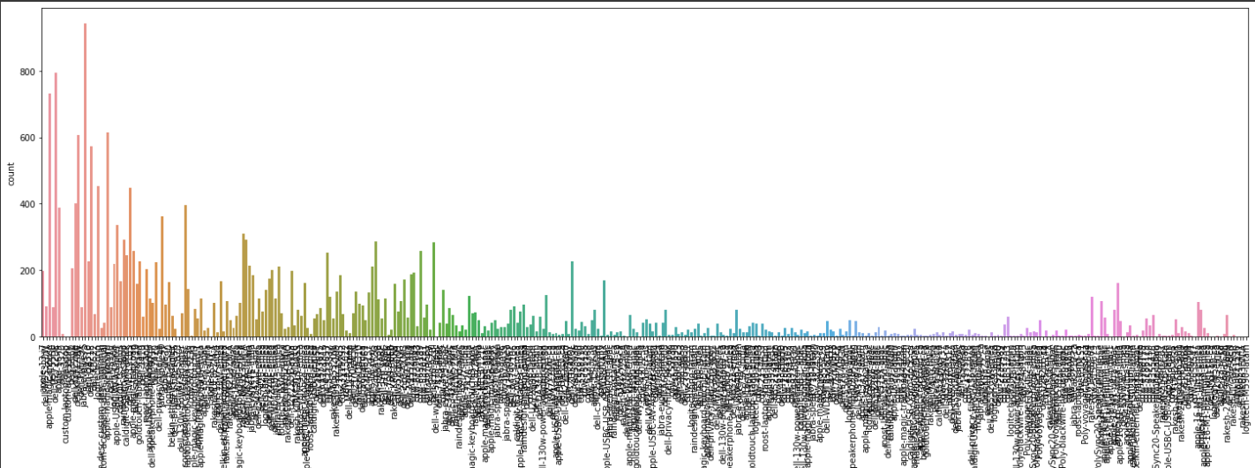
Data analysis (pattern)

Slide 16

Time series analysis
Decomposing series into:
Base level + Trend + Seasonality + error
Then examining the above categories for visualizing any presence of seasonality in data, if any then it is removed to detrend by Differencing and making the Series stationary by (once or more)
-Taking the log of the series
-Taking the nth root of the series
-Combination of the above.
Also depending on the time series it can be modified as additive and multiplicative and then making the mean, variance and auto correlation constant over time considering the previous values
Then performing the stationary test:
-Augmented Dickey Fuller test (ADH Test)
-Kwiatkowski-Phillips-Schmidt-Shin – KPSS test (trend stationary)
-Philips Perron test (PP Test)

Slide 17
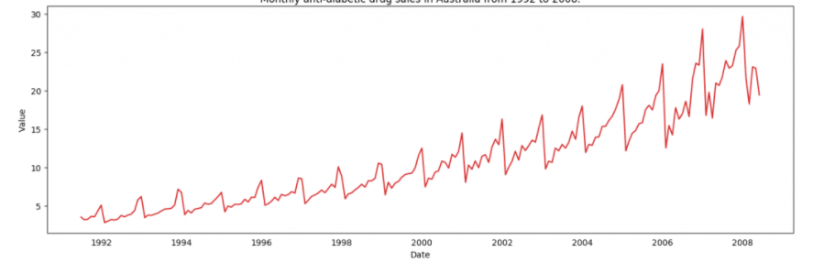
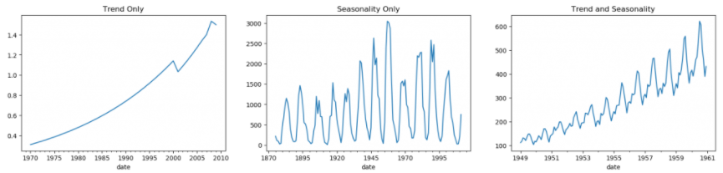
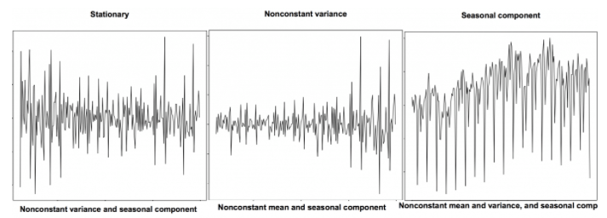
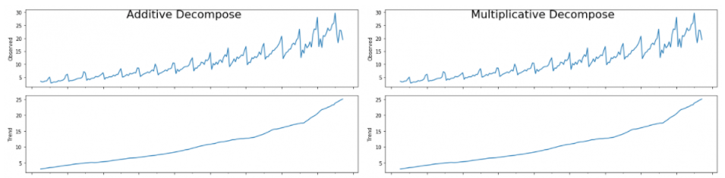
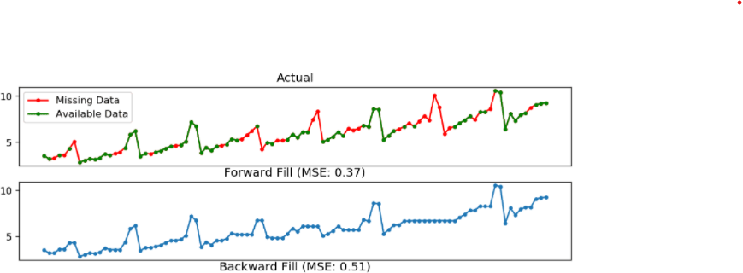
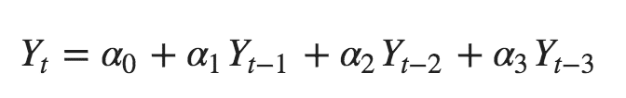
Time series analysis
Visualizing
Pattern
Check for Stationary
Detrending
Missing element
Deseasonlized
Auto correlation
Smoothening

Slide 18
Normalizing data
Normalization also makes the training process less sensitive to the scale of the features. This results in getting better coefficients after training.
This process of making features more suitable for training by rescaling is called feature scaling.
We are going to use standard scaler to directly stabilize the input by,
Using the default configuration and scale values to subtract the mean to center them on 0.0 and divide by the standard deviation to give the standard deviation of 1.0. First, a StandardScaler instance is defined with default hyperparameters.

Slide 19

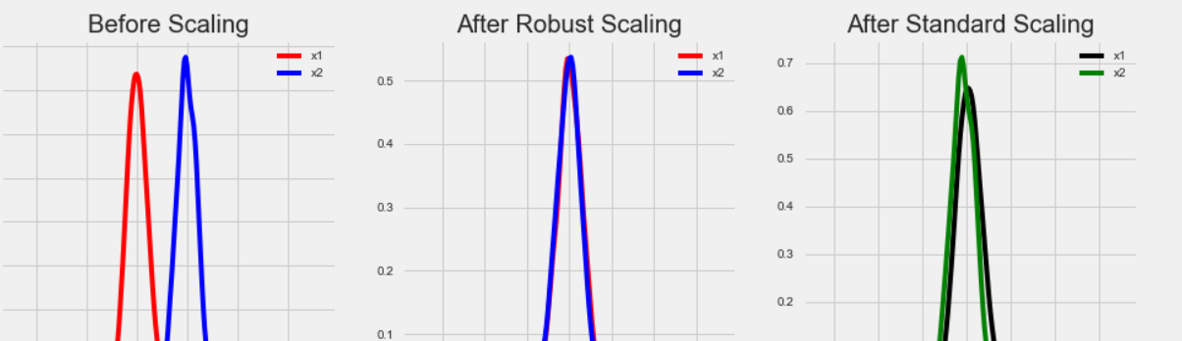
Comparison for normalizing data:
We are using standard scalar

Slide 20
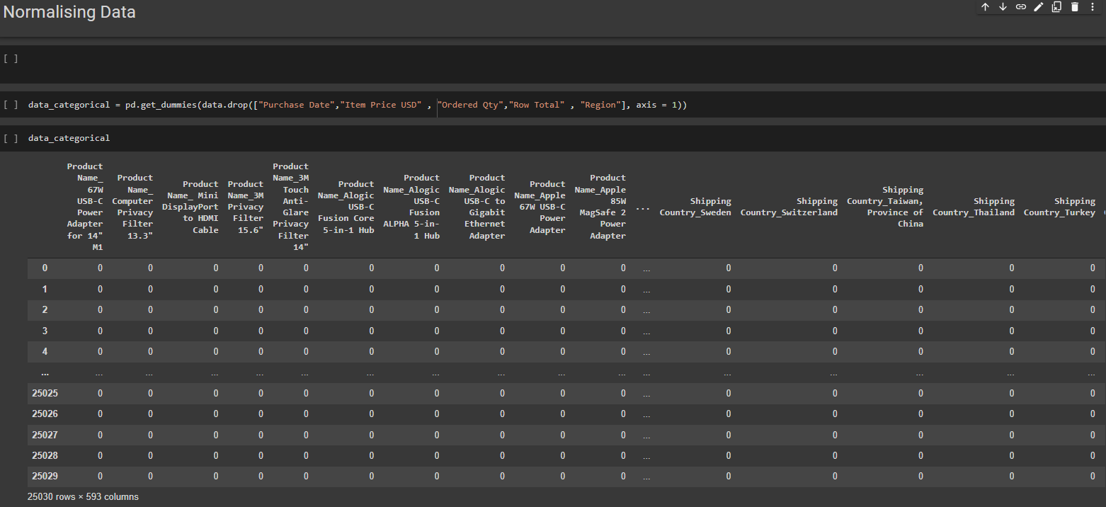
Normalizing data (code)

Slide 21
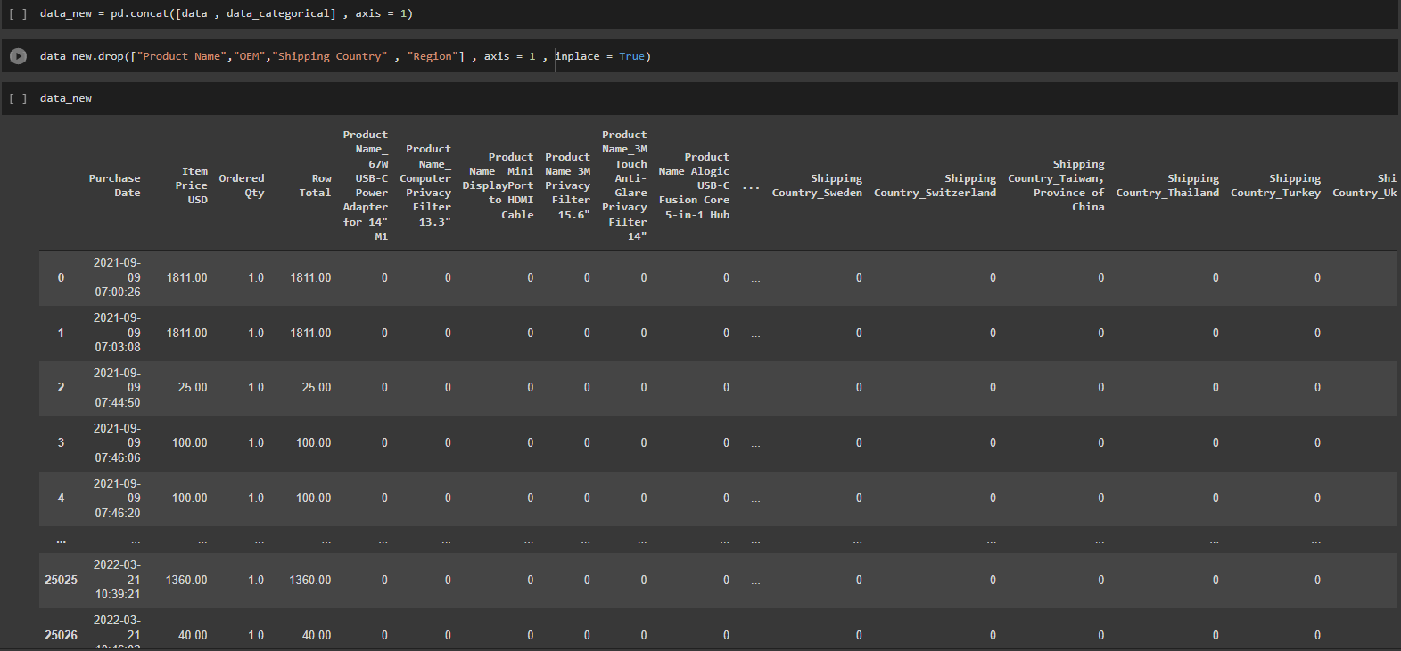
Normalizing data (code)

Slide 22
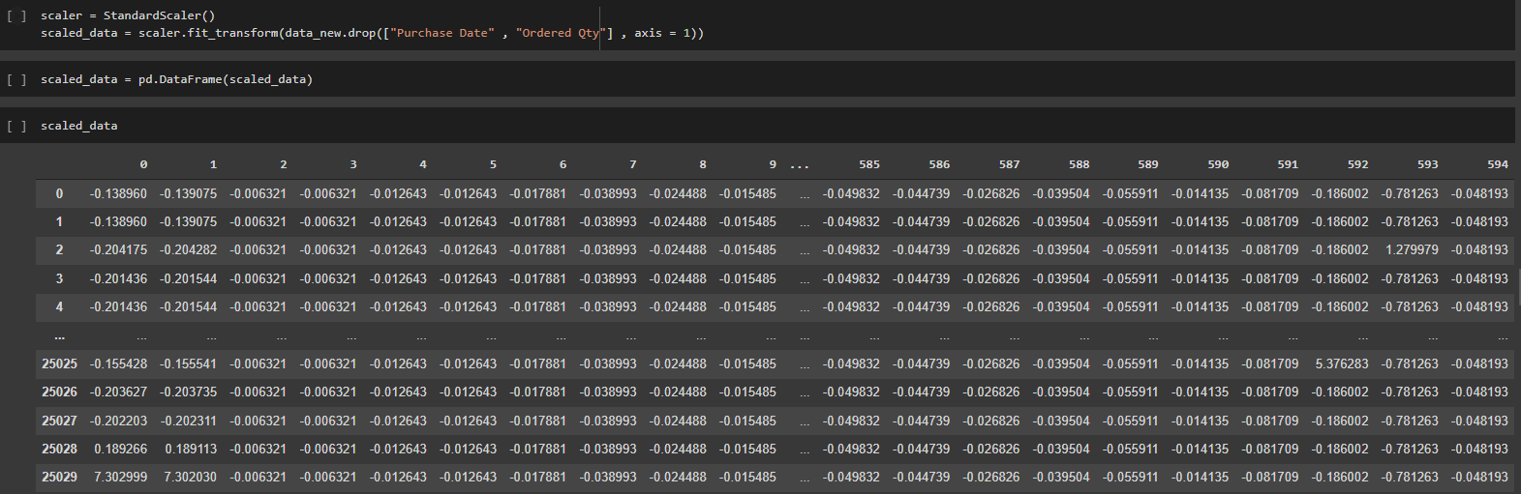
Normalizing data (code)

Slide 23
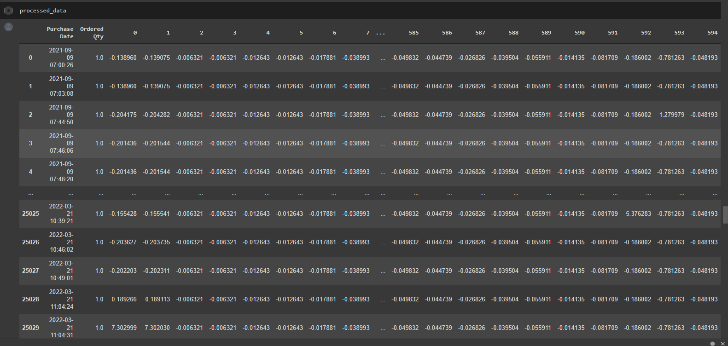
Normalizing data (code)

Slide 24
Forecasting
After following the procedure explained in previous slides
We are going to use the following models for predicting the forecast,
Linear Regression model which will be our base model for predicting the threshold value for further implementation. The value here will be compared with other machine learning models, for instance, if the value forecasted by any other method crosses this threshold value then the value will not be taken into consideration and will be evaluated for Hyper tuning. The continuing models include:
Cat boost
ARIMA / SARIMA
RNN, LSTM, BRNN

Slide 25
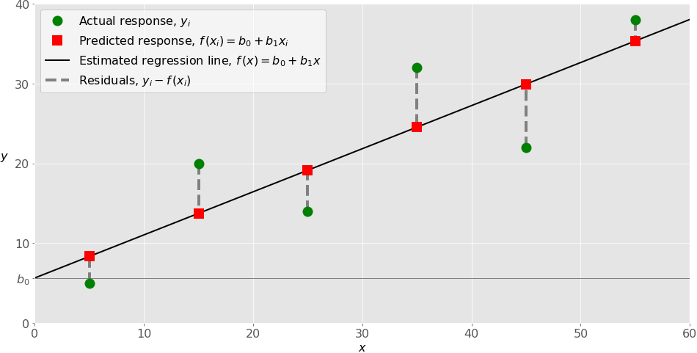
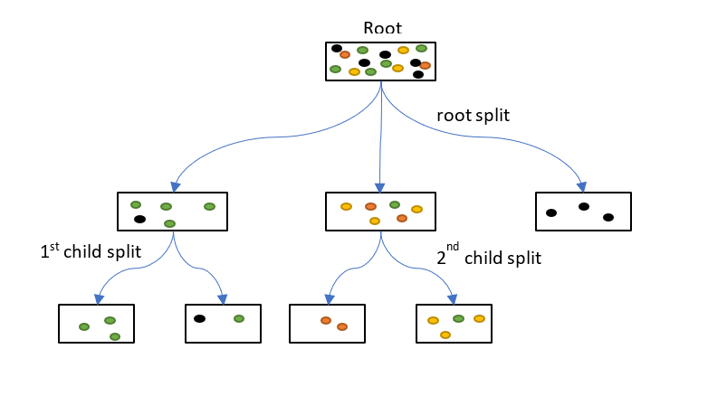
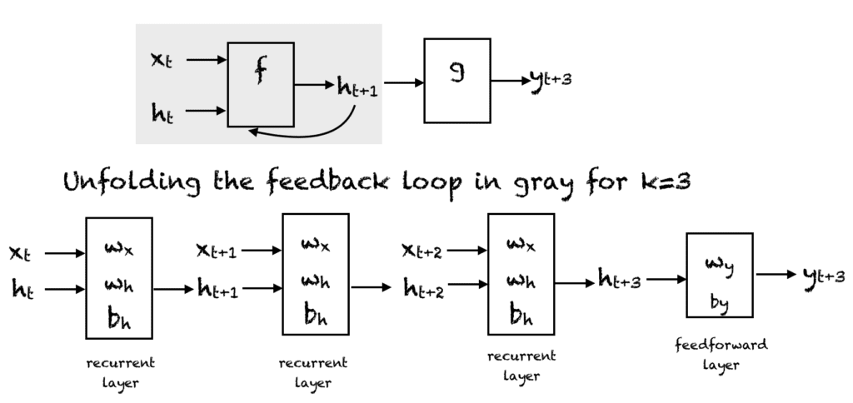
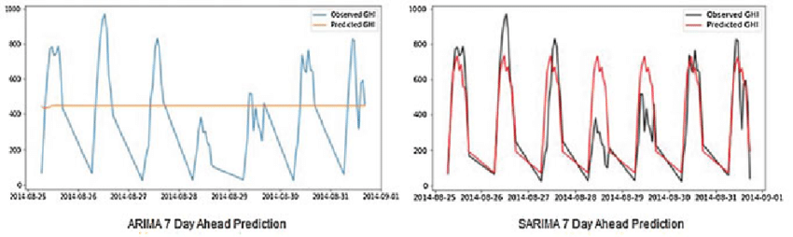
Forecasting using various mathematical models:
Linear Regression (base model)
Cat boost
Threshold compared (t)
If value > t, then hyper tuning
RNN, BRNN, LSTM
ARIMA/SARIMA

Slide 26
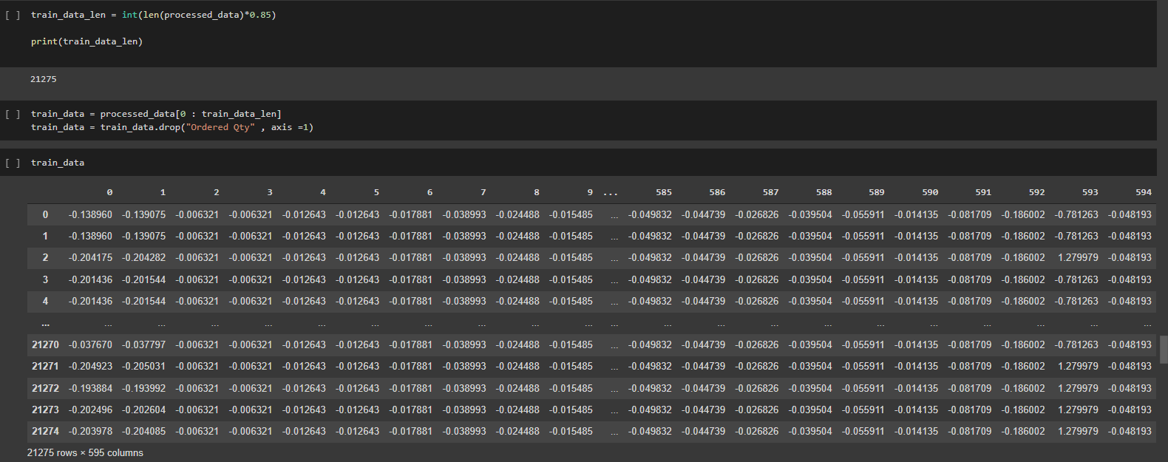
Training and test data set (code)

Slide 27
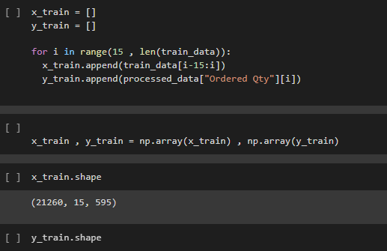
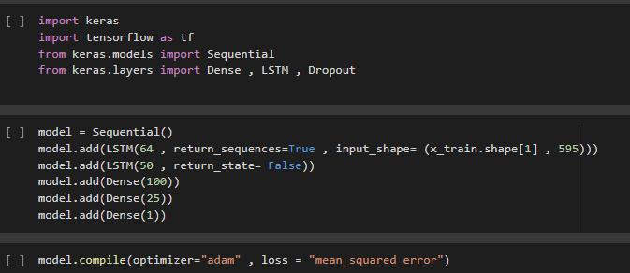
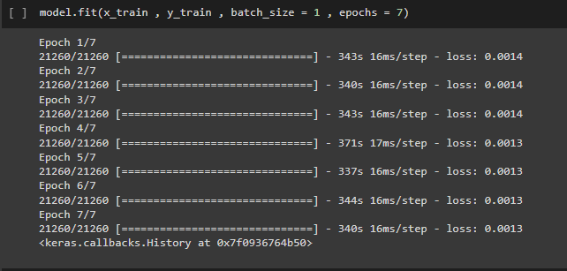
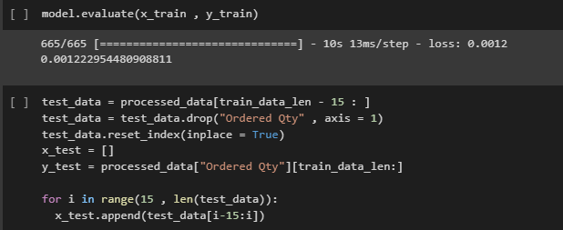
Training and test data set (code), Forecasting

Slide 28
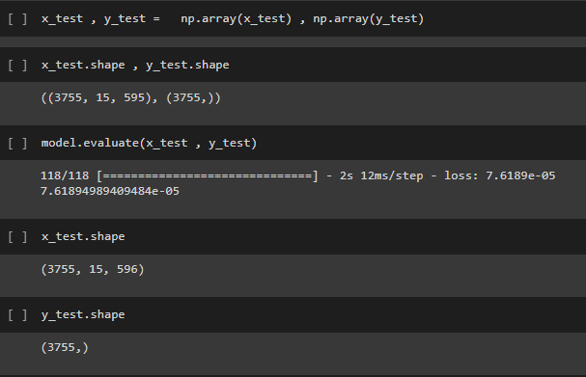
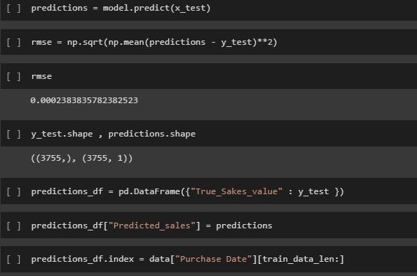
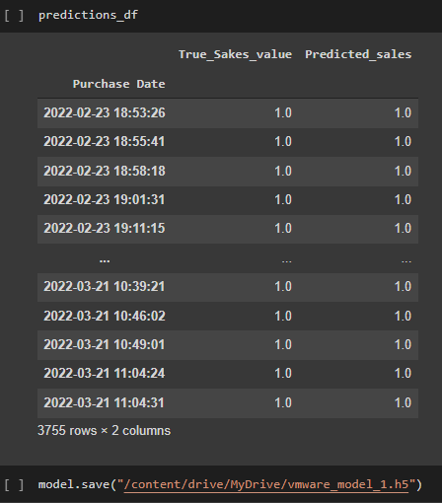
Forecasting(code)

Slide 29
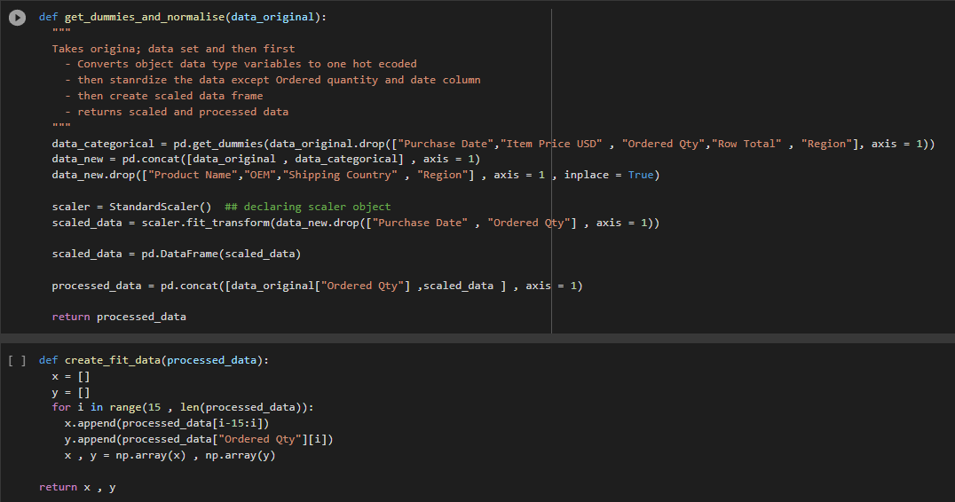
Dummies and Normalize (code)

Slide 30
Result from forecasting
The final result of the forecasting is produced to produce:
Ordering pattern in form of data representation fed through forecasting model.
Ordering forecast can be produced eventually from the above results with interactive simulations.
Screen shot of results on next slide →

Slide 31
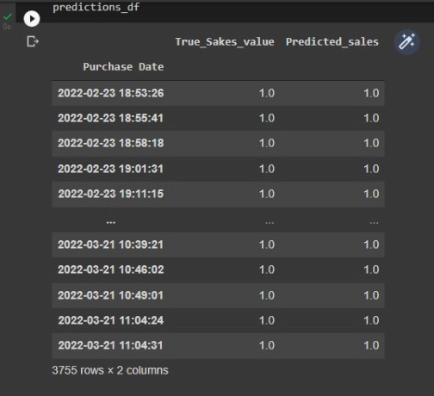
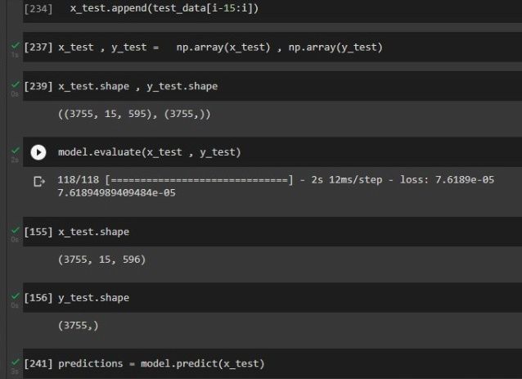
Result from forecasting (Screenshots)
1. Ordering forecast basis various KPI’s

Slide 32
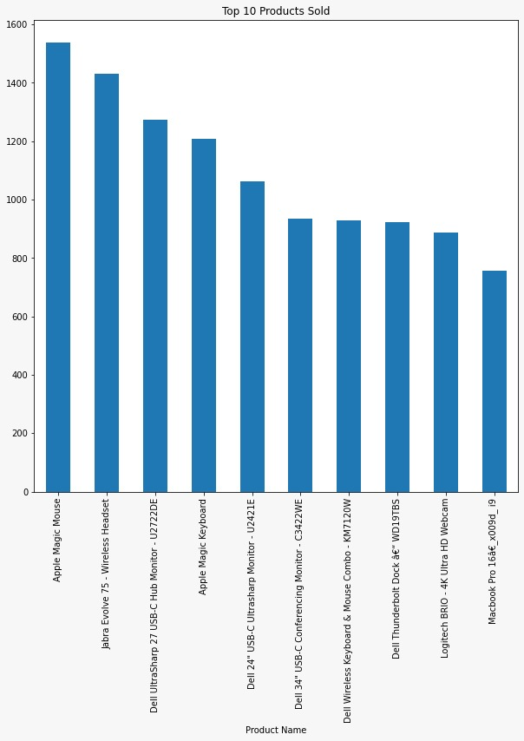
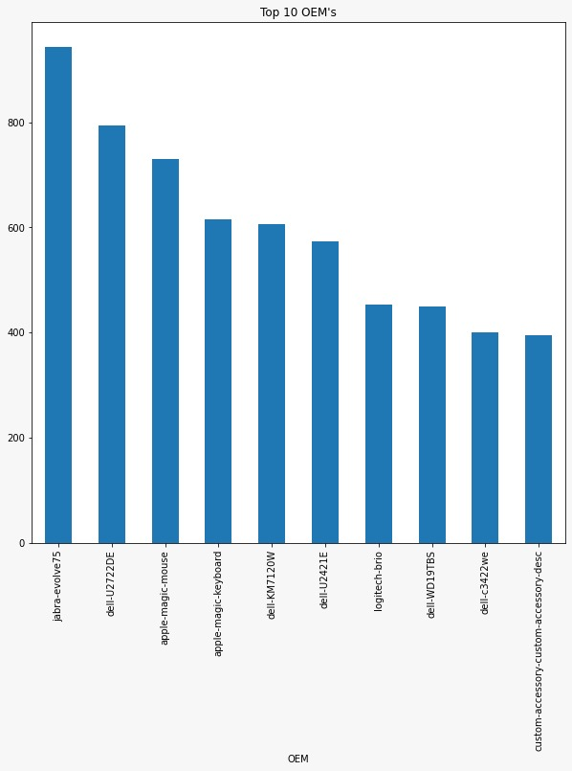
Result from forecasting (Pattern observed)
2. Ordering pattern basis various KPI’s

Slide 33
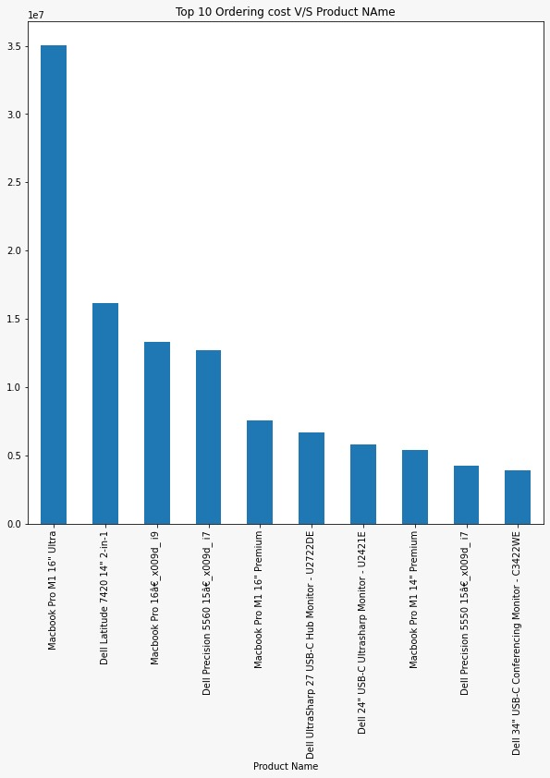
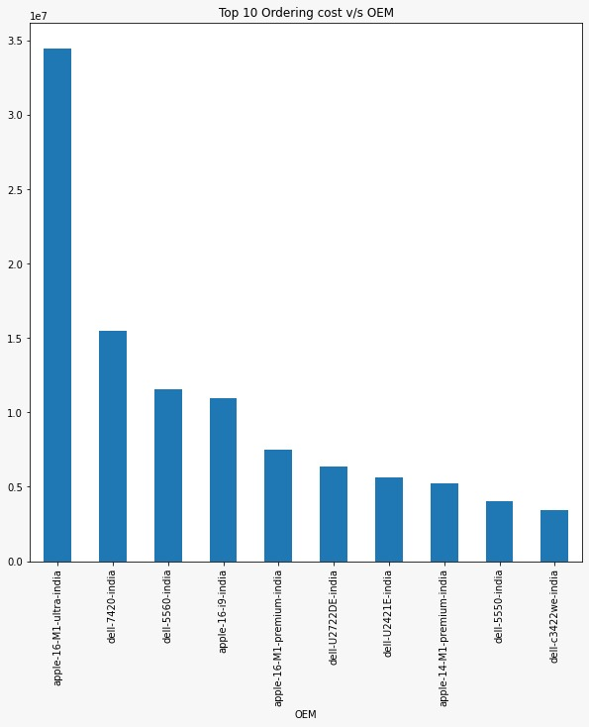
Result from forecasting (Pattern observed)

Slide 34
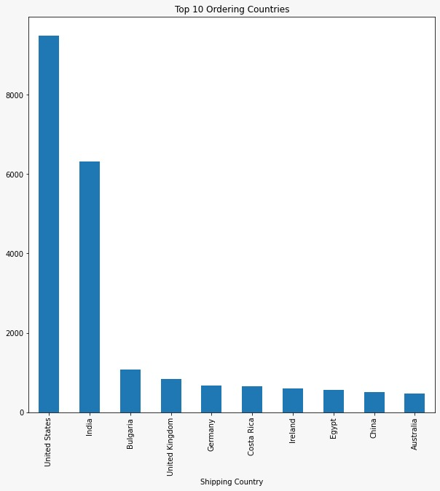
Result from forecasting (Pattern observed)

Slide 35
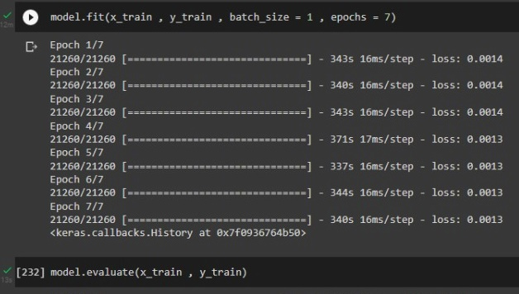
Accuracy details
The error incurred was 0.000001% which evaluates the forecast accuracy to 99.9999%, under the given conditions and will vary when working with more dataset.

Slide 36
Technical Stack
Language: Python
Modules Used : pandas, numpy, matplotlib, seaborn, sklearn
Dataset : oasis store data (provided) (pandas)
Data Analysis : Interpolation (seaborn)
Normalizing Data : StandardScaler (pandas)
Forecasting : LSTM base model, modules (keras, tensorflow)
Plotting : matplotlib

Slide 37
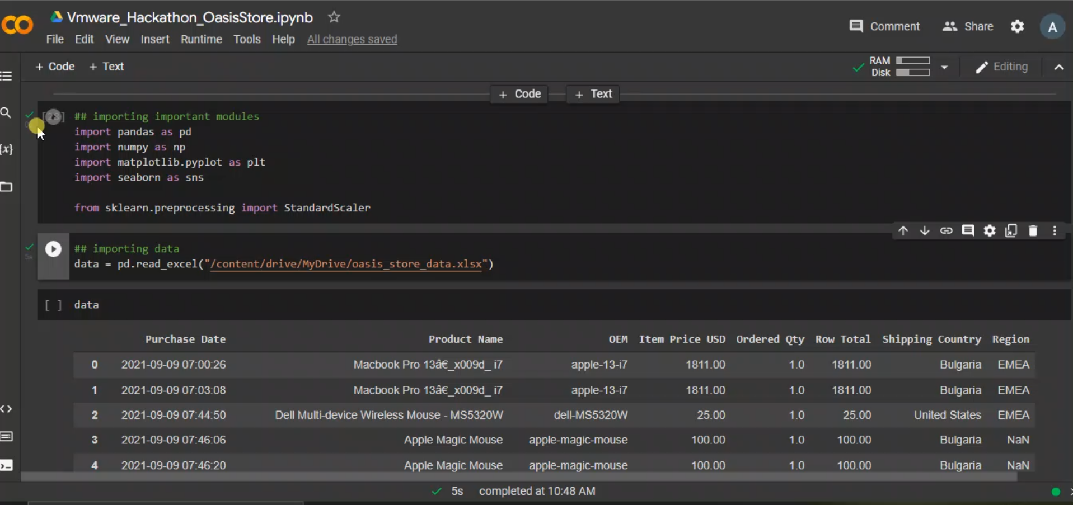
Demo video

Slide 38

Outcomes
Ordering pattern basis various KPI’s
Ordering forecast basis various KPI’s
Following the procedure for solution we will be able to plot the ordering pattern on the basis of various KPI’s by predicting the output and using visual implementation tools such as bar graph, histogram, pie chart etc. for efficient learning.
From the pattern produced and the values obtained a forecasted value can be produced for a particular time period which will not only keep in mind the past activities as well as the future dataset prediction which would eventually help In efficient inventory control and order rate.

Slide 39
Advantages
On the ability of storing historical data that is error free
On the basis of dealing the vanishing gradient problem and future inputs
On the basis of ability to handle data
Following procedure will make sure that the data handled is normalized as well detrend and stationary which is very important when dealing with large amount of data
Since we are using different types of model at once so there is multiple comparisons as well as the data is treated against a standard expected value and is made error free at each step.
Also the dataset treated is smoothened as far as possible before forecasting.
To overcome the problem of future inputs we are going to use the LSTM and Bidirectional RNN.
Since we will be dealing with large amount of data we will provide the weight gradient to the newest values possible and the upcoming future values so as to avoid vanishing gradient.

Slide 40
Limitations
Solution to Limitations
Computation will be slow
Faster application by sacrificing memory
As the application is slower we can provide more space to the following so that more functions can be processed at a single instance, this can make the application faster depending on the hardware provided.
Since we are focusing on the efficient result to minimize as much error as possible, we are involving so many procedures which will result in slower application.

Slide 41
Previous work
Problem Statement
Participants are expected to build a projection of the business potential for each of the 3915 regions (given in the dataset) for the next 12 months
Data set
There are a total of 3915 regions in the dataset
Train Dataset - Has the business potential of 3915 regions for months 1 to 72
Evaluation Dataset - You must predict the business potential of 3915 regions for Month 73 to Month 87
Certificate for Geo-informatics for biodiversity conservation planning using Machine learning
From IIRS ISRO Dehradun:
https://elearning.iirs.gov.in/edusat_lms/public/studentCertificate/MjAyMTkzMTM1ODQ5MA==/OTM=
Please find the project here :
https://github.com/amannaredi/IIT-Bombay-Techfest---Tata-Communications-Datathon/blob/ca893a5bcd62b0709ea9bc70d7246a27240360d3/DT-221642_Datathon/DT-221642_Datathon/Techfest_Datathon.ipynb

Slide 42

THANK YOU!

